Slide 1
Code Generation
CSE 430 (Compiler Design)
Instructor
Dr. Shamim H Ripon
http://www.ewubd.edu/~dshr

Slide 2
Code Generation
Produce the correct code
Semantically correct
High quality code (size and speed)
Generating optimal code is undecidable
In practice, use heuristic
Intermediate
Representation
Code
Generator
Target
Program

Slide 3
Design Issue
Input to Code generator
IR of the source program produced by front-end
Target Program
Instruction set of the target machine
RISC
CISC
JVM
Instruction Selection
Register Allocation
Register allocation
Register assignment
Evaluation Order

Slide 4
Basic Blocks and Flow Graphs
Graph representation of intermediate code (IC)
Blocks – Sequences of consecutive three-address instructions
Construction steps:
Partition the IC into Basic Blocks
Flow of control can only enter the basic block through the 1st instruction
Control leaves the block without halting or branching
Basic blocks become nodes of a flow graph – indicates which block can follow which other block

Slide 5
Basic Blocks
Partition the Three-address instruction into blocks
Steps:
Find leaders – first instruction in basic block
First instruction in IC is a leader
Any instruction that is target of a conditional or unconditional jump is a leader
Any instruction that immediately follows a conditional or unconditional jump is a leader
For each leader – its basic block consists of itself and all instructions up to the next leader

Slide 6
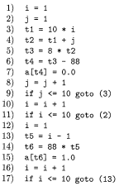
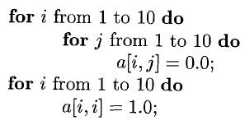
Basic Blocks
Rule - 1
Rule - 2
Rule - 3

Slide 7
Flow Graphs
Represents flow of control between blocks
Nodes of the graph are basic blocks
An edge from block B to block C iff
A conditional or unconditional jump from end of B to beginning of C
C immediately follows B in the original ordering of TAC and B does not end in an unconditional jump
B is predecessor of C and C is successor of B
Add two extra nodes:
Entry
Exit

Slide 8
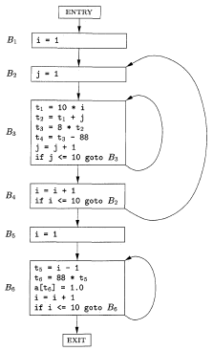
Flow Graphs

Slide 9
Blocks Optimization
Local optimization
Within each block
Global optimization
How information flows among the basic blocks
Represent basic blocks into DAG (directed acyclic graph)

Slide 10
DAG Representation
Steps:
A node for each of the initial values of variables appears in block
There is a node N associated with each statement S within block
Children of N are nodes corresponding to statements that are last definitions, prior to S, of the operand used by S
Node N is labelled by the operator applied at S
Attach the list of variables for which it is the last definition in the block
Output nodes
Variables are live on exit – their values may be used later in another block in the flow graph

Slide 11
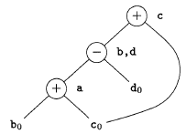
DAG of a Block
a = b + c
b = a – d
c = b + c
d = a - d

Slide 12
Improvements by DAG
Eliminate local common subexpressions – instructions that computer values that has already computed
Eliminate dead code – instructions that compute a value that is never used.
Reorder statements that do not depend on one another
Can apply algebraic laws to reorder operands of TAC

Slide 13
Instruction Selection – Tree Rewriting
Instruction selection for a target machine is a combinatorial problem.
Treat the instruction selection as a tree rewriting problem
Input to code generator will be a sequence of trees
Target code is generated by applying a sequence of rewriting rules to reduce the tree to a single node
Tree-rewriting rules are called tree-translation scheme.

Slide 14
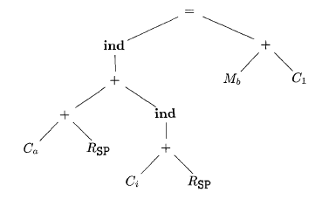
Intermediate-code Tree
Intermediate-code tree for a[i] = b + 1

Slide 15

Tree Translation Scheme
replacement ← template {action}

Slide 16
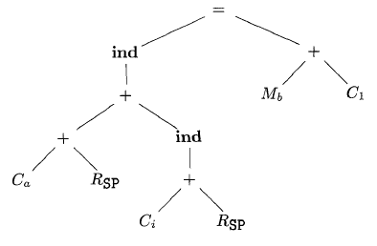
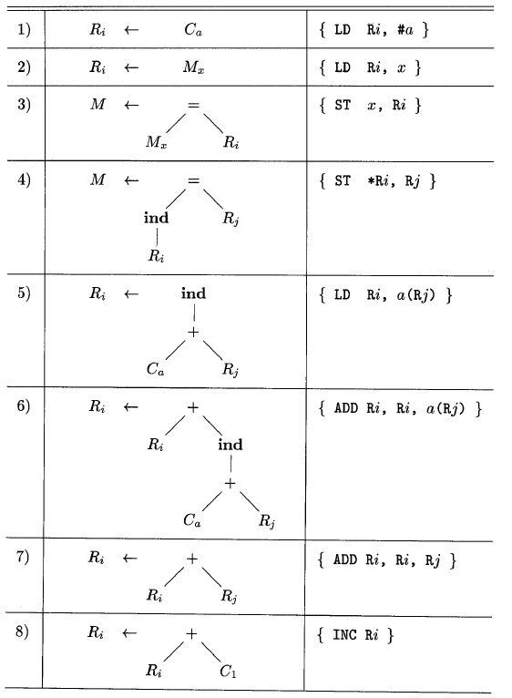

Slide 17
LD R0, #a
ADD R0, R0, SP
ADD R0, R0, i(SP)
LD R1, b
INC R1
ST *R0, R1
Some issues:
How pattern matching can be done
What do we do if more than one templates are matched
matching order may improve the efficiency.

